Slide 1

Olgica Djuric, May 8th 2024.

Slide 2


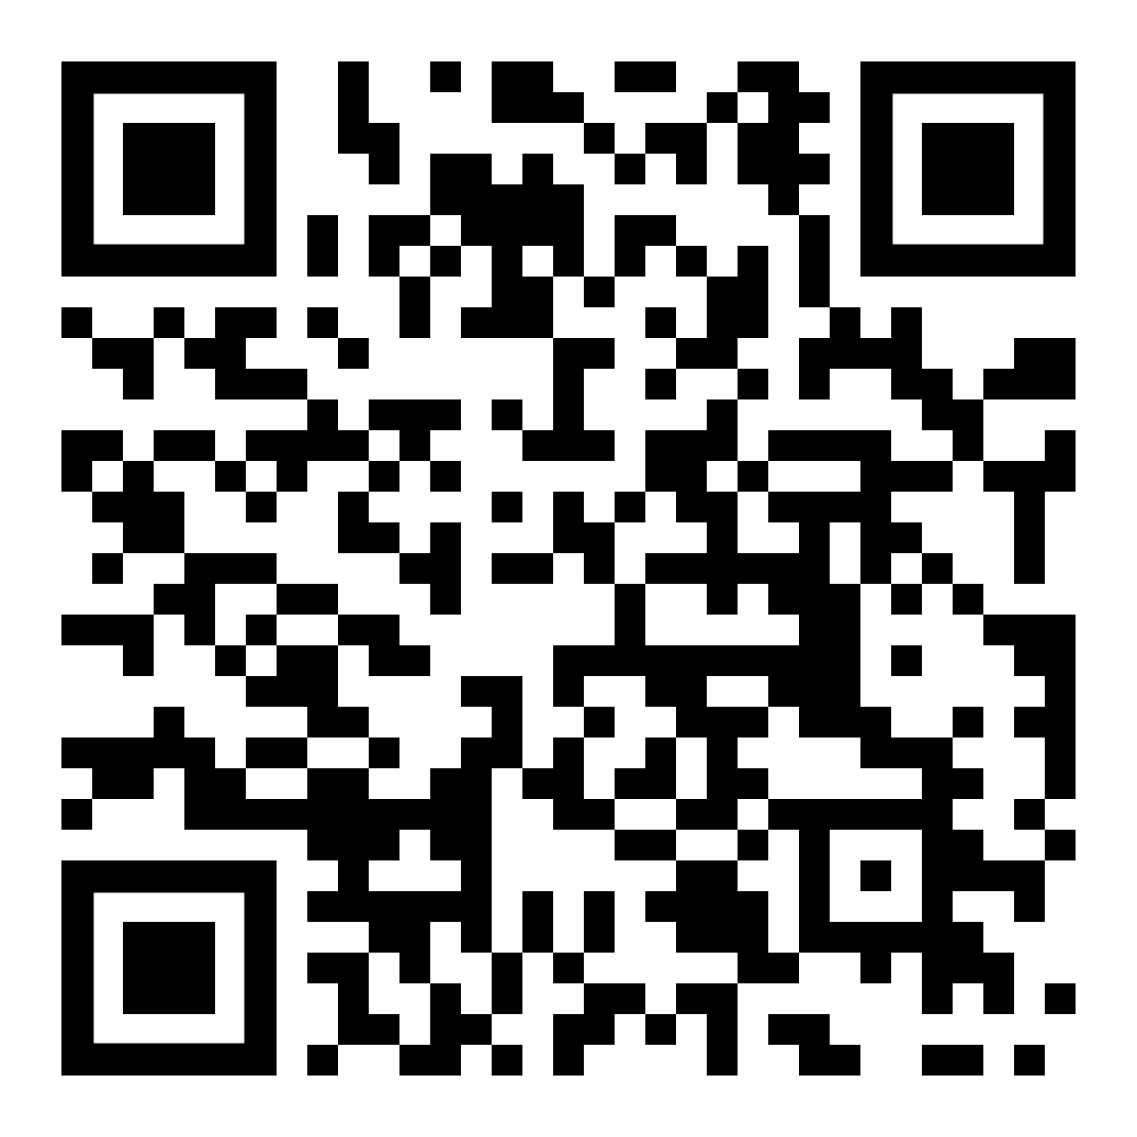
Olgica Djuric
(Ol·gee·tsa)
Software engineer, Certified Positive Intelligence Coach, Mental Fitness Trainer
olgica@ondjuric.com
ondjuric.com
github.com/ondjuric
github.com/ondjuric/talks/blob/main/tdd_resistance.md

Slide 3


Slide 4
A Programmer’s Resistance to
the Test-first approach
Agenda
Programmer’s journey
Intro to TDD and Mock
Life without TDD
Finding My Community
Applying On Legacy Codebase
Reflection on resistance and insights
Breakout rooms - reflection activity
Gratitude Q&A

Slide 5

Part I - Intro to TDD and Mock

Slide 6

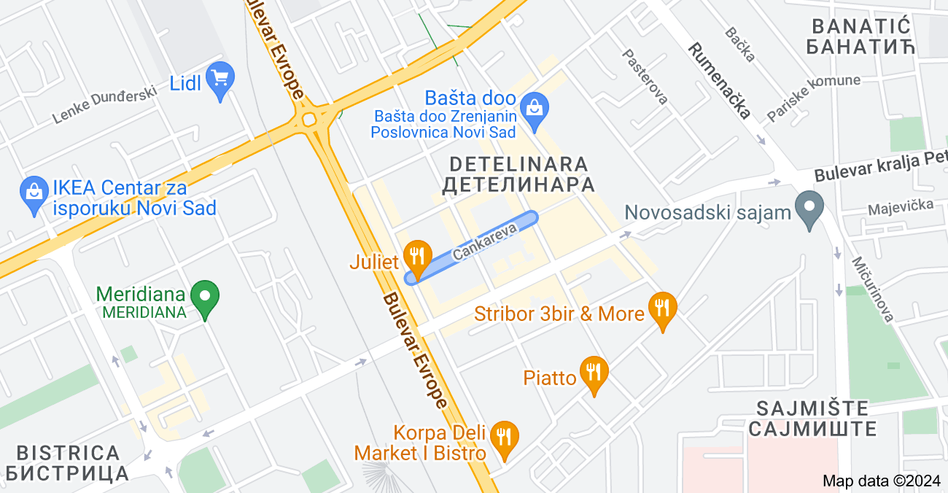
Part I - Intro to TDD and Mock

Slide 7
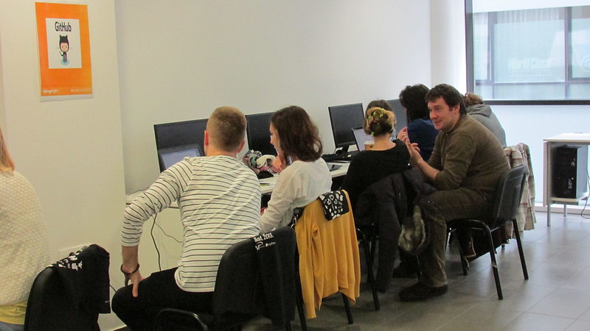
Part I - Intro to TDD and Mock

Slide 8




Part I - Intro to TDD and Mock
Test-First - Flow
Pseudo code
Refactor
Red
Green

Slide 9
Part I - Intro to TDD and Mock
Test-First - Benefits
Fail fast, a bug catcher
Documentation
Specification
Getting faster into domain
Evolve the design safely and incrementally
Robust code base
Improving coding skills
Safety net

Slide 10
Part II - Life without TDD

Slide 11

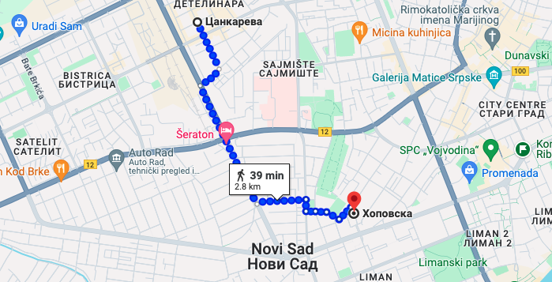
Part II - Life without TDD

Slide 12

Part II - Life without TDD

Slide 13

Part II - Life without TDD

Slide 14

Part II - Life without TDD

Slide 15

Part II - Life without TDD
Pseudo code
Refactor
Red
Green

Slide 16

Part II - Life without TDD

Slide 17


Part II - Life without TDD

Slide 18
Part III - Finding My Community

Slide 19

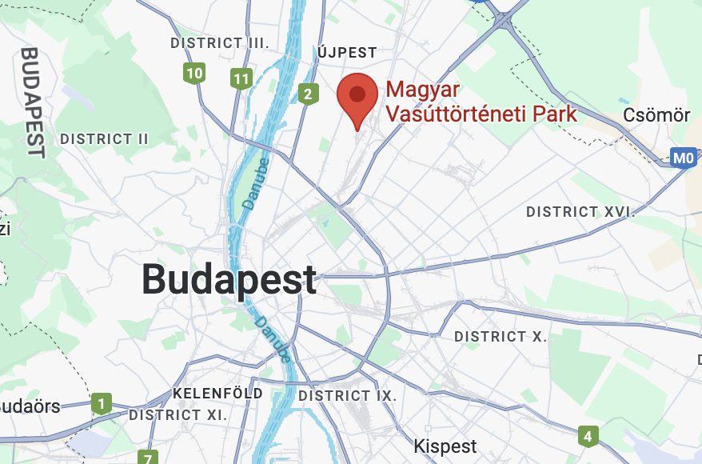
Part III - Finding My Community

Slide 20
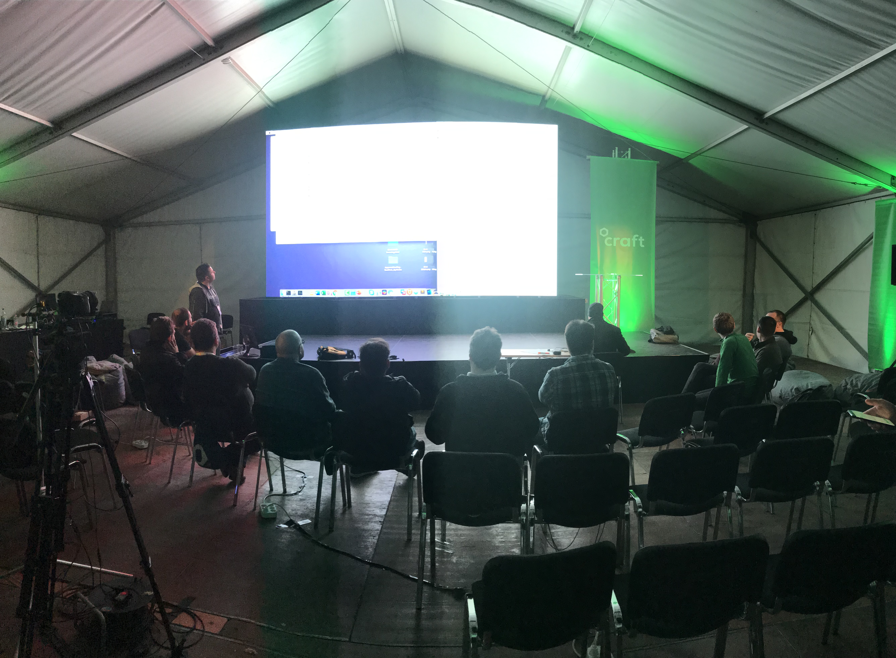
Part III - Finding My Community
Mob programming workshop, Craft Conf 2019.
Notes:
A whole team approach, synergy

Slide 21

Part III - Finding My Community
Kata
(ˈkädə)
Repetitio est mater studiorum.
2005 cadet world karate champion ^{[1]} Emmanuelle Fumonde performing a kata.

Slide 22
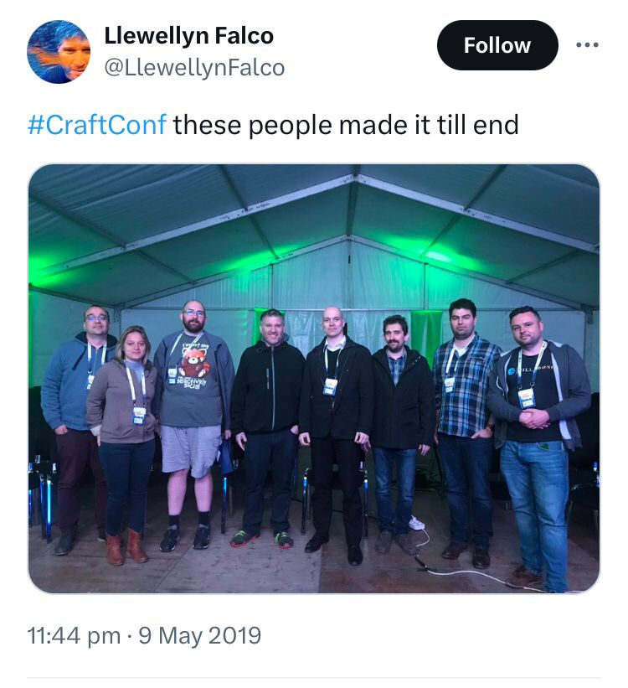
Part III - Finding My Community

Slide 23
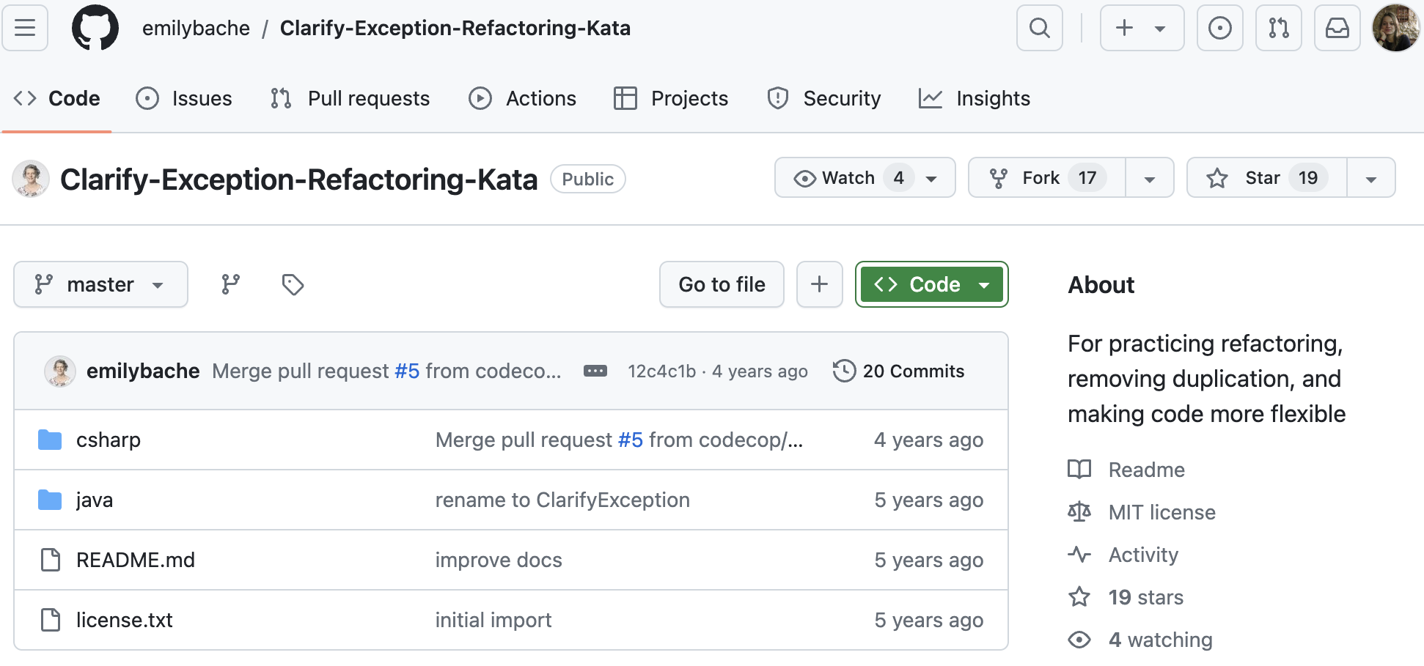
Part III - Finding My Community
https://github.com/emilybache/Clarify-Exception-Refactoring-Kata

Slide 24

Part III - Finding My Community
A picture’s worth a 1000 tests.
Unit testing - primitive type
Unit testing - complex object
assertEquals(5, person.getAge())
Approvals.verify(person)

Slide 25
Part III - Finding My Community
1. Create your scenario
2. Write that scenario in your mother language*
3. Write that scenario in English
4. Translate English to Code
5. Create Code so it works
6. Run your test for feedback while you code
7. Approve result so it continues to work
8. Change the requirement
9. See the new solution
10. Re-Approve so it continues to work

Slide 26
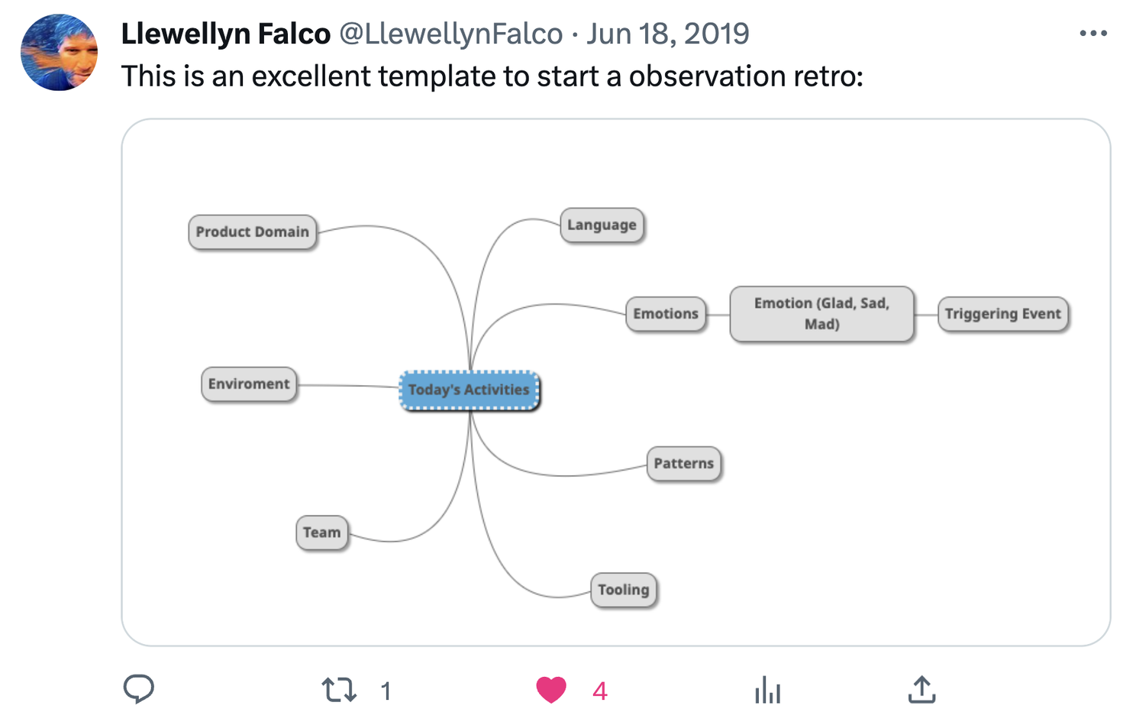
Part III - Finding My Community

Slide 27
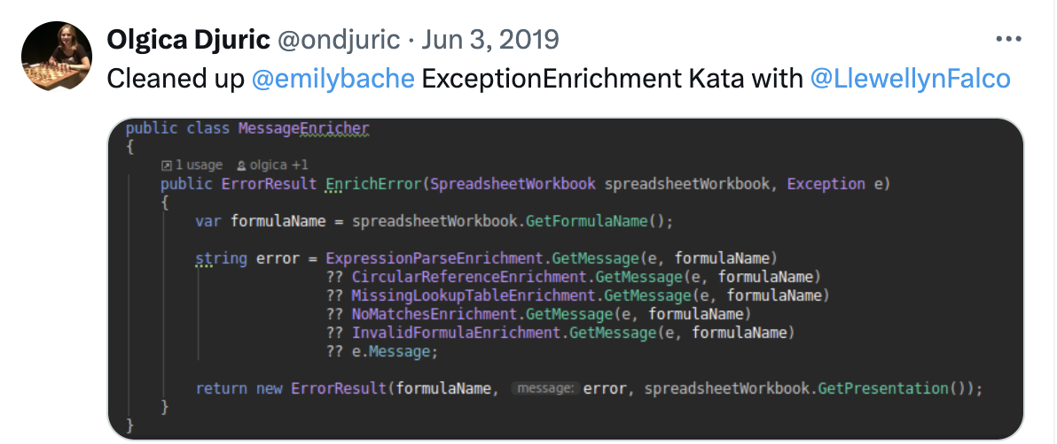
Part III - Finding My Community

Slide 28
Part IV - Applying on Legacy

Slide 29

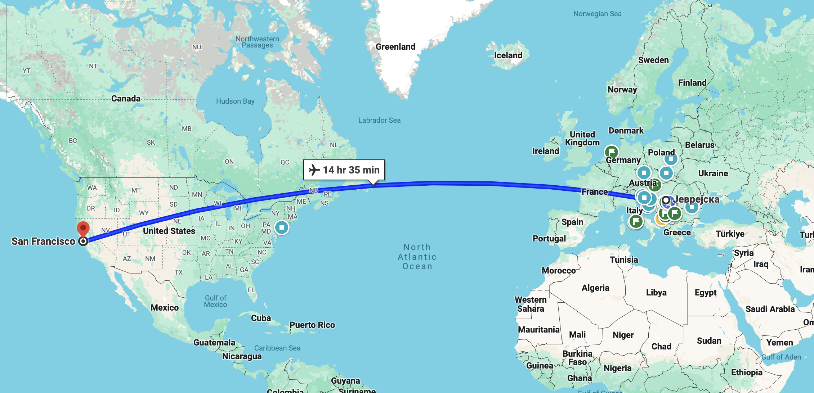
Part IV - Applying on Legacy

Slide 30
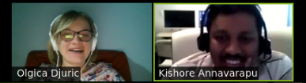
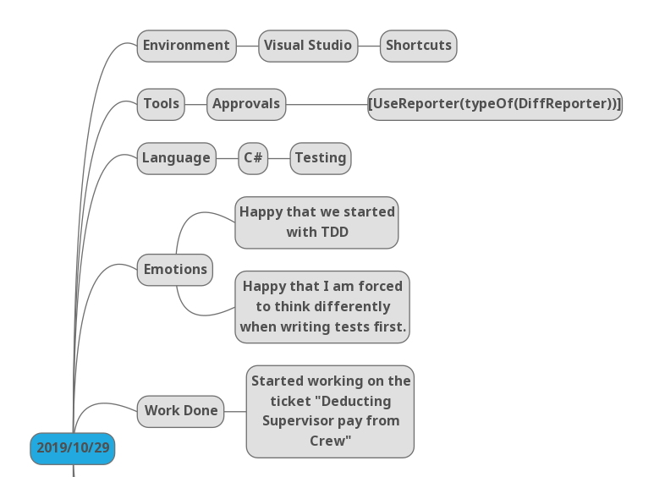
Part IV - Applying on Legacy

Slide 31
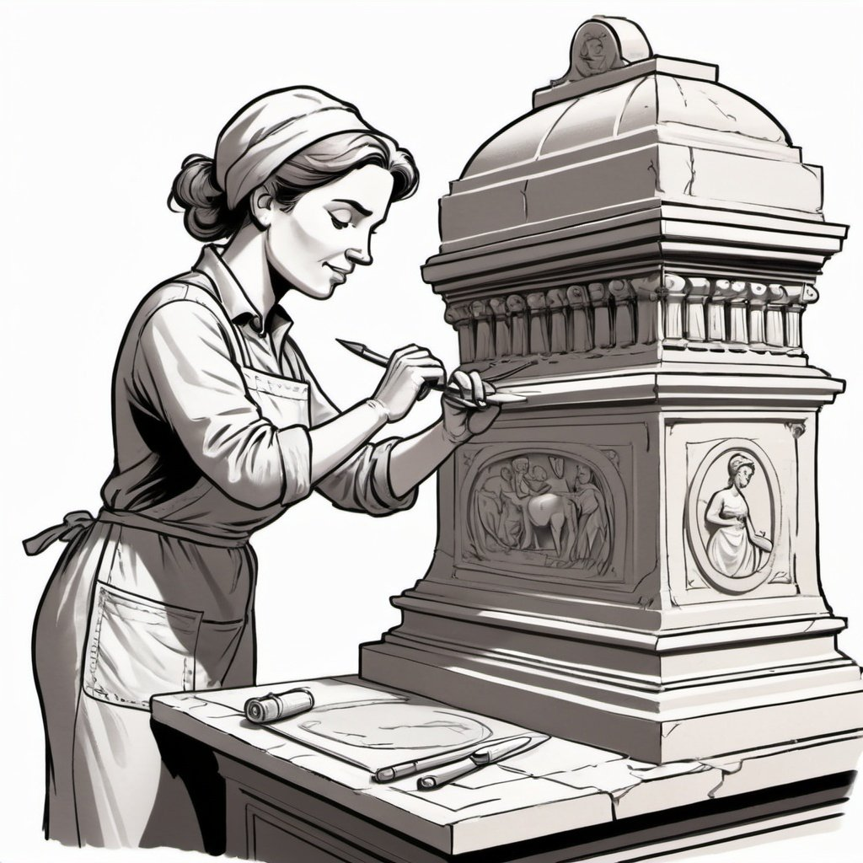
Part IV - Applying on Legacy

Slide 32

Part IV - Applying on Legacy
5
4
3
2
1

Slide 33
Part V - Reflection

Slide 34
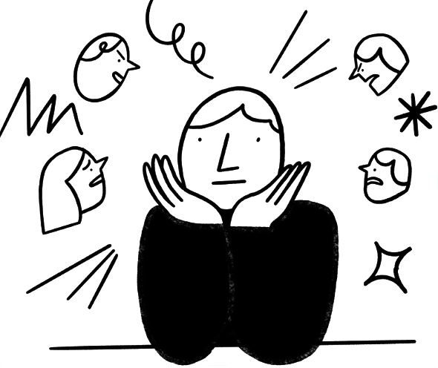
Reflection On Resistance
Sabotaging voices
Judging and sabotaging:
Self
Others
Circumstances

Slide 35

Reflection On Resistance
Sabotaging voices
The Judge
“You are paid to know.”

Slide 36

Reflection On Resistance
Sabotaging voices
The Avoider
“I’ll just stick to what I know.”

Slide 37
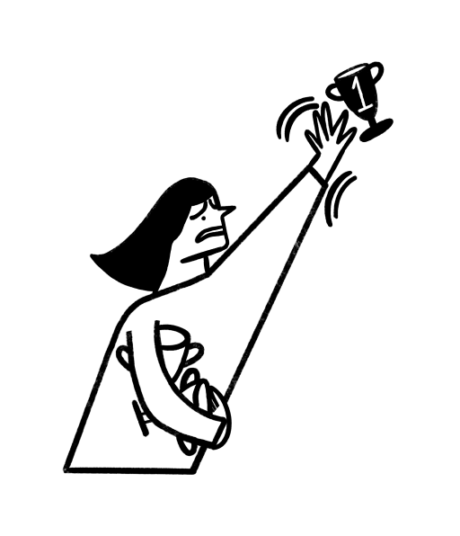
Reflection On Resistance
Sabotaging voices
The Hyper-Achiever
“I don’t have time for TDD.
I need to learn this new framework.”

Slide 38

Reflection On Resistance
Sabotaging voices
The Restless
“Docker. Angular. Django.Micro-services.”

Slide 39
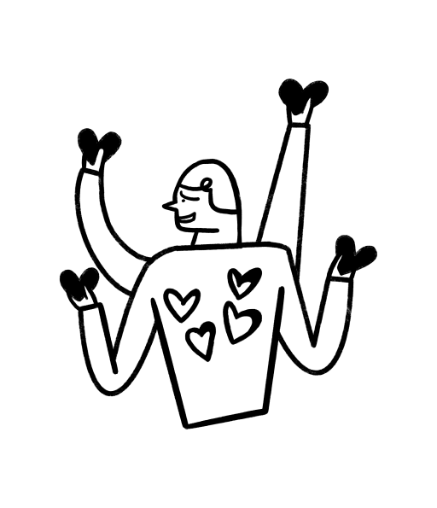
Reflection On Resistance
Sabotaging voices
The Pleaser
“Yes.”

Slide 40

Reflection On Resistance
Sabotaging voices
The Hyper-Rational
“I know it. I used it once.”

Slide 41
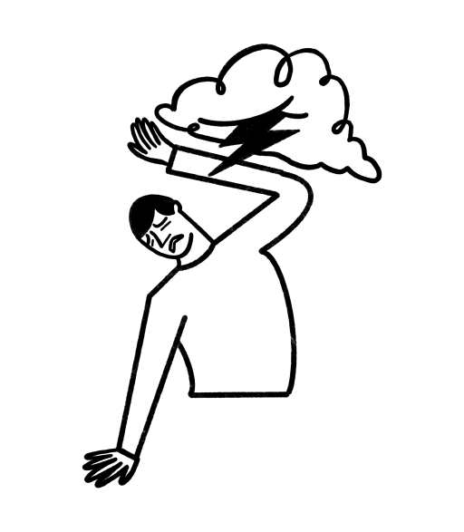
Reflection On Resistance
Sabotaging voices
The Victim
“Poor me…”

Slide 42
A Programmer’s Resistance to
the Test-first approach
Tech - Starting kit
Coding together, Community, Supportive environment
Developing refactoring and TDD skills is one of the most compassionate things you can do for yourself and your peers
Get familiar with:
Terminology and syntax
Unit Test - Arrange, Act, Assert & Given, When, Then
What the Mock? - Mock library in your ecosystem
Approval Tests
Refactoring catalog
Java by Comparison
Refactoring tool/plugin in your IDE

Slide 43
Reflection On Resistance
Saboteurs - Breakout room
Which saboteur are you recognising in you?
How strong is it?
What’s its biggest impact?
github.com/ondjuric/talks/blob/main/tdd_resistance.md

Slide 44

Reflection On Resistance
Saboteurs - Sabotaging voices - Examples
 | TDD is wasting of time. You should focus on pushing out new features instead.
 | TDD and refactoring seem too complicated. I'll just stick to what I know.
 | I don't trust automated tests to catch all the bugs. I'd rather manually test everything.
 | I don't have time for TDD and refactoring; I need to learn this new framework.
 | I managed to apply it once, and read some cool book on TDD, and now I know it. No need to practice it further.
Judge
Avoider
Controller
Hyper-Achiever
Hyper-Rational
©2022 Positive Intelligence, LLC

Slide 45

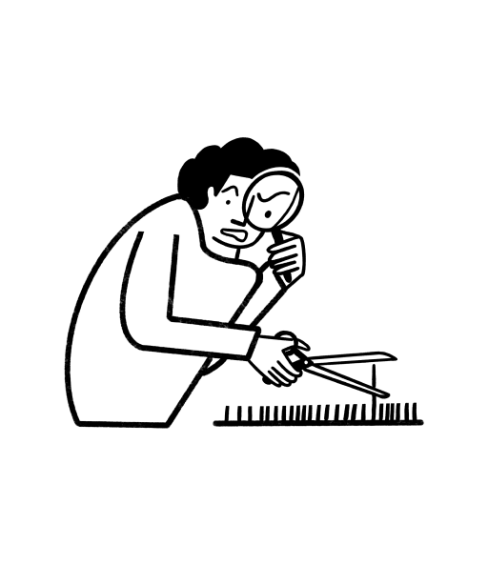
Reflection On Resistance
Saboteurs - Sabotaging voices - Examples
 | I'm worried that if I start TDD, I need to refactor, and I’ll never finish. It's better to leave things as they are.
 | I don't want to rock the boat by suggesting TDD. I'll just go along with what everyone else is doing.
 | I am missing out on more interesting stuff. I can do better than what I am doing now.
 | I can't refactor this code until it conforms to all our design guidelines. It has to be perfect.
 | TDD won't make a difference. My codebase is too far gone to salvage.
Hyper-Vigilant
Pleaser
Restless
Stickler
Victim
©2022 Positive Intelligence, LLC

Slide 46
A Programmer’s Resistance to
the Test-first approach
Challenge
Experiment going 10% beyond your comfort zone and be OK with “messy”.
Do the TDD of yourself :)

Slide 47
Thank you
Olgica Djuric
(Ol·gee·tsa)
olgica@ondjuric.com
ondjuric.com
github.com/ondjuric
github.com/ondjuric/talks/blob/main/tdd_resistance.md

Slide 48


